Slide 1

LUNG TRANSPLANTATION
Pediatric Recipients
2014
JHLT. 2014 Oct; 33(10): 1025-1033
Notes:
Analysis excludes living donor transplants unless specifically stated otherwise.

Slide 2
Table of Contents
Donor, recipient and center characteristics: slides 3-18
Post transplant: survival and other outcomes: slides 19-36
Induction and maintenance immunosuppression: slides 37-43
Post transplant morbidities: slides 44-60
Multivariable analyses: slides 61-69
2014
JHLT. 2014 Oct; 33(10): 1025-1033

Slide 3
Donor, Recipient and Center Characteristics
2014
JHLT. 2014 Oct; 33(10): 1025-1033
Notes:
Analysis excludes living donor transplants unless specifically stated otherwise.

Slide 4
Pediatric Lung Transplants
Recipient Age Distribution – Number
(Transplants: January 1986 – June 2013)
2014
Analysis includes deceased and living donor transplants.
JHLT. 2014 Oct; 33(10): 1025-1033

Slide 5
Pediatric Lung Transplants
Recipient Age Distribution – Percentage
(Transplants: January 1986 – June 2013)
2014
Analysis includes deceased and living donor transplants.
JHLT. 2014 Oct; 33(10): 1025-1033

Slide 6
Pediatric Lung Transplants
Donor Type Distribution by Transplant Year
(Transplants: January 1986 – December 2012)
NOTE: This figure includes only the lung transplants that are reported to the ISHLT Transplant Registry. As such, the presented data may not reflect the changes in the number of lung transplants performed worldwide.
2014
Analysis includes deceased and living donor transplants.
JHLT. 2014 Oct; 33(10): 1025-1033

Slide 7
Pediatric Lung Transplants
Donor Type Distribution by Recipient Age Group Within Era
(Transplants: January 1986 – June 2013)
2014
Analysis includes deceased and living donor transplants.
JHLT. 2014 Oct; 33(10): 1025-1033

Slide 8
Pediatric Lung Transplants
Donor Age Distribution
(Transplants: January 1986 – June 2013)
2014
JHLT. 2014 Oct; 33(10): 1025-1033
Notes:
Transplants with unknown donor ages are excluded from this tabulation.

Slide 9
Pediatric Lung Transplants
Donor and Recipient Age (Transplants: January 2000 – June 2013)
2014
JHLT. 2014 Oct; 33(10): 1025-1033

Slide 10
Pediatric Lung Transplants
Recipient Age Distribution by Year of Transplant
NOTE: This figure includes only the pediatric lung transplants that are reported to the ISHLT Transplant Registry. Therefore, these numbers should not be interpreted as the rate of change in pediatric lung procedures performed worldwide.
2014
Analysis includes deceased and living donor transplants.
JHLT. 2014 Oct; 33(10): 1025-1033

Slide 11
Pediatric Lung Retransplants by Year of Retransplant
2014
Only patients who were less than 18 years old at the time of retransplant are included.
JHLT. 2014 Oct; 33(10): 1025-1033

Slide 12
Pediatric Lung Transplants
Number of Centers Reporting Transplants by Location
(Transplants: January 1986 – December 2012)
2014
Analysis includes deceased and living donor transplants.
JHLT. 2014 Oct; 33(10): 1025-1033

Slide 13
Pediatric Lung Transplants
Number of Centers Reporting Transplants by Pediatric Center Volume
2014
Analysis includes deceased and living donor transplants.
JHLT. 2014 Oct; 33(10): 1025-1033

Slide 14
Pediatric Lung Transplants
Number of Transplants by Pediatric Center Volume
2014
Analysis includes deceased and living donor transplants.
JHLT. 2014 Oct; 33(10): 1025-1033

Slide 15
Pediatric Lung Transplants
Indications by Age Group (Transplants: January 1990 – June 2013)
Diagnosis | < 1 Year |  | 1-5 Years |  | 6-10 Years |  | 11-17 Years
Cystic Fibrosis | 1 | 1.0% | 6 | 4.5% | 148 | 52.3% | 968 | 69.7%
Idiopathic Pulmonary Arterial Hypertension | 12 | 12.1% | 30 | 22.6% | 26 | 9.2% | 109 | 7.8%
Retransplant: Obliterative Bronchiolitis | 0 |  | 7 | 5.3% | 9 | 3.2% | 40 | 2.9%
Congenital Heart Disease | 16 | 16.2% | 11 | 8.3% | 4 | 1.4% | 12 | 0.9%
Idiopathic Pulmonary Fibrosis | 10 | 10.1% | 21 | 15.8% | 16 | 5.7% | 47 | 3.4%
Obliterative Bronchiolitis, Not Retx | 0 |  | 10 | 7.5% | 23 | 8.1% | 58 | 4.2%
Retransplant, Not OB | 3 | 3.0% | 4 | 3.0% | 8 | 2.8% | 37 | 2.7%
Interstitial Pneumonitis | 1 | 1.0% | 2 | 1.5% | 2 | 0.7% | 1 | 0.1%
Pulmonary Vascular Disease | 8 | 8.1% | 8 | 6.0% | 4 | 1.4% | 1 | 0.1%
Eisenmenger’s Syndrome | 1 | 1.0% | 5 | 3.8% | 3 | 1.1% | 9 | 0.6%
Pulmonary Fibrosis, Other | 8 | 8.1% | 12 | 9.0% | 15 | 5.3% | 28 | 2.0%
Surfactant Protein B Deficiency | 17 | 17.2% | 5 | 3.8% | 0 |  | 0
COPD/Emphysema | 4 | 4.0% | 2 | 1.5% | 2 | 0.7% | 10 | 0.7%
Bronchopulmonary Dysplasia | 3 | 3.0% | 3 | 2.3% | 6 | 2.1% | 3 | 0.2%
Bronchiectasis | 1 | 1.0% | 0 |  | 2 | 0.7% | 18 | 1.3%
Other | 14 | 14.1% | 7 | 5.3% | 15 | 5.3% | 48 | 3.5%
2014
Analysis includes deceased and living donor transplants. For some retransplants diagnosis other than retransplant is reported, so the total percentage of retransplants may be greater.
JHLT. 2014 Oct; 33(10): 1025-1033
Notes:
Transplants with unknown diagnoses are excluded from this tabulation.

Slide 16
Pediatric Lung Transplants
Age Distribution by Location
(Transplants: January 2000 – June 2013)
2014
Analysis includes deceased and living donor transplants.
JHLT. 2014 Oct; 33(10): 1025-1033

Slide 17
Pediatric Lung Transplants
Diagnosis Distribution by Location
(Transplants: January 2000 – June 2013)
Total number of transplants reported:
Europe = 512
North America = 712
Other = 86
For some retransplants diagnosis other than retransplant is reported, so the total percentage of retransplants may be greater.
2014
NOTE: Unknown diagnoses were excluded from this tabulation. Analysis includes deceased and living donor transplants.
JHLT. 2014 Oct; 33(10): 1025-1033

Slide 18
Pediatric Lung Transplants
Donor Age Distribution by Location
(Transplants: January 2000 – June 2013)
NOTE: Transplants with unknown donor age and living donor transplants were excluded from this tabulation.
Total number of transplants reported:
Europe = 512
North America = 712
Other = 86
2014
JHLT. 2014 Oct; 33(10): 1025-1033

Slide 19
Post Transplant:
Survival and Other Outcomes
2014
JHLT. 2014 Oct; 33(10): 1025-1033
Notes:
Analysis excludes living donor transplants unless specifically stated otherwise.

Slide 20
Lung Transplants
Kaplan-Meier Survival by Recipient Age Group
(Transplants: January 1990 – June 2012)
p = 0.4400
2014
JHLT. 2014 Oct; 33(10): 1025-1033
Notes:
Survival was calculated using the Kaplan-Meier method, which incorporates information from all transplants for whom any follow-up has been provided. Since many patients are still alive and some patients have been lost to follow-up, the survival rates are estimates rather than exact rates because the time of death is not known for all patients. The median survival is the estimated time point at which 50% of all of the recipients have died. Survival rates were compared using the log-rank test statistic. Results of log-rank test should be interpreted with caution when curves cross.

Slide 21
Lung Transplants
Kaplan-Meier Survival by Recipient Age Group and Procedure Type (Transplants: January 1990 – June 2012)
Adult, Bilateral/ Double vs. Adult, Single: p<0.0001
Adult, Bilateral/ Double vs. Pediatric: p=0.0003
Adult, Single vs. Pediatric: p<0.0001
2014
JHLT. 2014 Oct; 33(10): 1025-1033
Notes:
Survival was calculated using the Kaplan-Meier method, which incorporates information from all transplants for whom any follow-up has been provided. Since many patients are still alive and some patients have been lost to follow-up, the survival rates are estimates rather than exact rates because the time of death is not known for all patients. The median survival is the estimated time point at which 50% of all of the recipients have died.
Survival rates were compared using the log-rank test statistic. Adjustments for multiple comparisons were done using Scheffe’s method. Results of log-rank test should be interpreted with caution when curves cross.

Slide 22
Pediatric Lung Transplants
Kaplan-Meier Survival by Procedure Type
(Transplants: January 1990 – June 2012)
p<0.0001
2014
JHLT. 2014 Oct; 33(10): 1025-1033
Notes:
Survival was calculated using the Kaplan-Meier method, which incorporates information from all transplants for whom any follow-up has been provided. Since many patients are still alive and some patients have been lost to follow-up, the survival rates are estimates rather than exact rates because the time of death is not known for all patients. The median survival is the estimated time point at which 50% of all of the recipients have died.
Survival rates were compared using the log-rank test statistic.

Slide 23
Pediatric Lung Transplants
Kaplan-Meier Survival by Diagnosis
(Transplants: January 1990 – June 2012)
p=0.6070
2014
JHLT. 2014 Oct; 33(10): 1025-1033
Notes:
Survival was calculated using the Kaplan-Meier method, which incorporates information from all transplants for whom any follow-up has been provided. Since many patients are still alive and some patients have been lost to follow-up, the survival rates are estimates rather than exact rates because the time of death is not known for all patients. The median survival is the estimated time point at which 50% of all of the recipients have died.
Survival rates were compared using the log-rank test statistic. Results of log-rank test should be interpreted with caution when curves cross.

Slide 24
Pediatric Lung Transplants
Kaplan-Meier Survival by Recipient Age Group
(Transplants: January 1990 – June 2012)
Pair-wise comparisons were not significant at p<0.05.
N at risk = 25
2014
JHLT. 2014 Oct; 33(10): 1025-1033
Notes:
Survival was calculated using the Kaplan-Meier method, which incorporates information from all transplants for whom any follow-up has been provided. Since many patients are still alive and some patients have been lost to follow-up, the survival rates are estimates rather than exact rates because the time of death is not known for all patients. The median survival is the estimated time point at which 50% of all of the recipients have died.
Survival rates were compared using the log-rank test statistic. Adjustments for multiple comparisons were done using Scheffe’s method. Results of log-rank test should be interpreted with caution when curves cross. With only small number of transplants available for analysis in the tail, the p-value may be affected by the outcomes of just a few transplants.

Slide 25
Pediatric Lung Transplants
Conditional Kaplan-Meier Survival by Recipient Age Group
(Transplants: January 1990 – June 2012)
Pair-wise comparisons were not significant at p<0.05.
N at risk = 25
2014
JHLT. 2014 Oct; 33(10): 1025-1033
Notes:
Survival was calculated using the Kaplan-Meier method, which incorporates information from all transplants for whom any follow-up has been provided. Since many patients are still alive and some patients have been lost to follow-up, the survival rates are estimates rather than exact rates because the time of death is not known for all patients.
This figure shows survival conditional on survival to 1 year. Therefore, only patients surviving to at least 1 year were included in the calculation. The conditional median survival is the estimated time point at which 50% of the recipients who survive to at least 1 year have died. Because the decline in survival is greatest during the first year following transplantation, the conditional survival provides a more realistic expectation of survival time for recipients who survive the early post-transplant period.
Survival rates were compared using the log-rank test statistic. Adjustments for multiple comparisons were done using Scheffe’s method. Results of log-rank test should be interpreted with caution when curves cross. With only small number of transplants available for analysis in the tail, the p-value may be affected by the outcomes of just a few transplants.

Slide 26
Pediatric Lung Transplants
Kaplan-Meier Survival by Era
(Transplants: January 1988 – June 2012)
1988-1999 vs. 2000-2005: p=0.004
1988-1999 vs. 2006-6/2012: p<0.0001
2000-2005 vs. 2006-6/2012 is not significant at p<0.05.
N at risk = 12
2014
JHLT. 2014 Oct; 33(10): 1025-1033
Notes:
Survival was calculated using the Kaplan-Meier method, which incorporates information from all transplants for whom any follow-up has been provided. Since many patients are still alive and some patients have been lost to follow-up, the survival rates are estimates rather than exact rates because the time of death is not known for all patients.
The median survival is the estimated time point at which 50% of all of the recipients have died. The conditional median survival is the estimated time point at which 5% of the recipients who survive to at least 1 year have died. Because the decline in survival is greatest during the first year following transplantation, the conditional survival provides a more realistic expectation of survival time for recipients who survive the early post-transplant period.
Survival rates were compared using the log-rank test statistic. Adjustments for multiple comparisons were done using Scheffe’s method.

Slide 27
Pediatric Lung Transplants
Kaplan-Meier Survival by Donor Age for Recipients Age 11-17 Years (Transplants: January 1990 – June 2012)
N at risk = 12
N at risk = 11
N at risk = 10
2014
JHLT. 2014 Oct; 33(10): 1025-1033
Notes:
Survival was calculated using the Kaplan-Meier method, which incorporates information from all transplants for whom any follow-up has been provided. Since many patients are still alive and some patients have been lost to follow-up, the survival rates are estimates rather than exact rates because the time of death is not known for all patients. The median survival is the estimated time point at which 50% of all of the recipients have died.
Survival rates were compared using the log-rank test statistic. Adjustments for multiple comparisons were done using Scheffe’s method. Results of log-rank test should be interpreted with caution when curves cross.

Slide 28
Pediatric Lung Transplants
Kaplan-Meier Survival by Donor Type for Recipients Age 11-17 Years (Transplants: January 1990 – June 2012)
p = 0.1743
2014
JHLT. 2014 Oct; 33(10): 1025-1033
Notes:
Survival was calculated using the Kaplan-Meier method, which incorporates information from all transplants for whom any follow-up has been provided. Since many patients are still alive and some patients have been lost to follow-up, the survival rates are estimates rather than exact rates because the time of death is not known for all patients. The median survival is the estimated time point at which 50% of all of the recipients have died.
Survival rates were compared using the log-rank test statistic.

Slide 29
Pediatric Lung Transplants
Kaplan-Meier Survival for Living Donor Transplant Recipients Age 11-17 Years by Era (Transplants: January 1990 – June 2012)
p = 0.8516
2014
JHLT. 2014 Oct; 33(10): 1025-1033
Notes:
Survival was calculated using the Kaplan-Meier method, which incorporates information from all transplants for whom any follow-up has been provided. Since many patients are still alive and some patients have been lost to follow-up, the survival rates are estimates rather than exact rates because the time of death is not known for all patients.
Survival rates were compared using the log-rank test statistic. Results of log-rank test should be interpreted with caution when curves cross.

Slide 30
Pediatric Lung Retransplants
(Retransplants: January 1994 – June 2013)
2014
Analysis includes deceased and living donor transplants.
JHLT. 2014 Oct; 33(10): 1025-1033

Slide 31
Pediatric Lung Transplants
Kaplan-Meier Survival by Transplant Type
(Transplants: January 1994 – June 2012)
p<0.0001
N at risk = 246
2014
JHLT. 2014 Oct; 33(10): 1025-1033
Notes:
Survival was calculated using the Kaplan-Meier method, which incorporates information from all retransplants for whom any follow-up has been provided. Since many patients are still alive and some patients have been lost to follow-up, the survival rates are estimates rather than exact rates because the time of death is not known for all patients.
Survival rates were compared using the log-rank test statistic.

Slide 32
Pediatric Lung Transplants
Survival by Transplant Type and Inter-Transplant Interval
(Transplants: January 1988 – June 2012)
N at risk = 388
Analysis includes deceased and living donor transplants. Only patients who were less than 18 years old at the time of retransplant are included.
2014
JHLT. 2014 Oct; 33(10): 1025-1033
Notes:
Retransplants with unknown inter-transplant interval are excluded from this tabulation.
Survival was calculated using the Kaplan-Meier method, which incorporates information from all retransplants for whom any follow-up has been provided. Since many patients are still alive and some patients have been lost to follow-up, the survival rates are estimates rather than exact rates because the time of death is not known for all patients.
Survival rates were compared using the log-rank test statistic. Adjustments for multiple comparisons were done using Scheffe’s method.

Slide 33
Pediatric Lung Retransplants
Survival by Diagnosis
(Transplants: January 1988 – June 2012)
Analysis includes deceased and living donor transplants. Only patients who were less than 18 years old at the time of retransplant are included.
2014
JHLT. 2014 Oct; 33(10): 1025-1033
Notes:
Retransplants with unknown diagnosis are excluded from this tabulation.
Survival was calculated using the Kaplan-Meier method, which incorporates information from all retransplants for whom any follow-up has been provided. Since many patients are still alive and some patients have been lost to follow-up, the survival rates are estimates rather than exact rates because the time of death is not known for all patients.
Survival rates were compared using the log-rank test statistic.

Slide 34
Pediatric Lung Transplants
Functional Status of Surviving Recipients
(Follow-ups: March 2005 – June 2013)
2014
JHLT. 2014 Oct; 33(10): 1025-1033
Notes:
Functional status is collected using Karnofsky score for adult recipients and Lansky score for pediatric recipients.
This figure shows the functional status reported on the 1-year, 2-year and 3-year annual follow-ups. Because all follow-ups between March 2005 and June 2013 were included, the bars do not include the same patients.

Slide 35
Pediatric Lung Transplants
Rehospitalization Post-transplant of Surviving Recipients
(Follow-ups: April 1994 – June 2013)
2014
JHLT. 2014 Oct; 33(10): 1025-1033
Notes:
This figure shows the hospitalizations reported on the 1-year, 3-year and 5-year annual follow-ups, representing the hospitalizations between discharge and 1 year, between the 2-year and 3-year follow-up and between the 4-year and 5-year follow-up, respectively. Because all follow-ups between April 1994 and June 2013 were included, the bars do not include the same patients.

Slide 36
Pediatric Lung Transplants
Rehospitalization Post-transplant of Surviving Recipients
(Follow-ups: April 1994 – June 2013)
2014
JHLT. 2014 Oct; 33(10): 1025-1033
Notes:
This figure shows the hospitalizations reported between discharge and 1 year, between the 1-year and 3-year follow-up, and between the 3-year and 5-year follow-up, respectively. Because all follow-ups between April 1994 and June 2013 were included, the bars do not include the same patients.

Slide 37
Induction and Maintenance Immunosuppression
2014
JHLT. 2014 Oct; 33(10): 1025-1033
Notes:
Analysis excludes living donor transplants unless specifically stated otherwise.

Slide 38
Pediatric Lung Transplants
Induction Immunosuppression
(Transplants: January 2001 – June 2013)
2014
Analysis is limited to patients who were alive at the time of the discharge.
JHLT. 2014 Oct; 33(10): 1025-1033

Slide 39
Pediatric Lung Transplants
Induction Immunosuppression
(Transplants: January 2001 – June 2013)
2014
Analysis is limited to patients who were alive at the time of the discharge.
JHLT. 2014 Oct; 33(10): 1025-1033

Slide 40
Pediatric Lung Transplants
Kaplan-Meier Survival Stratified by Induction Use
(Transplants: January 2001 – June 2012)
p=0.8870
2014
JHLT. 2014 Oct; 33(10): 1025-1033
Notes:
Survival was calculated using the Kaplan-Meier method, which incorporates information from all transplants for whom any follow-up has been provided. Since many patients are still alive and some patients have been lost to follow-up, the survival rates are estimates rather than exact rates because the time of death is not know for all patients.
Survival rates were compared using the log-rank test statistic.

Slide 41
Pediatric Lung Transplants
Maintenance Immunosuppression at Time of Follow-up
(Follow-ups: January 2001 – June 2013)
2014
Analysis is limited to patients who were alive at the time of the follow-up.
JHLT. 2014 Oct; 33(10): 1025-1033
Notes:
This figure shows the maintenance immunosuppression reported as being provided at the time of the 1-year and 5-year annual follow-up forms. To provide a snapshot of current practice, only follow-ups occurring between January 2001 and June 2013 were included. Therefore, this figure does not represent changes in practice between the 1-year follow-up and 5-year follow-up on a cohort of patients. The patients in the 1-year tabulation are not the same patients as in the 5-year tabulation.

Slide 42
Pediatric Lung Transplants
Maintenance Immunosuppression at Time of Follow-up
(Follow-ups: January 2001 – June 2013)
NOTE: 0.2% of patients were on both calcineurin inhibitors at different point during the 1-year; these patients are not counted in either group. And no patients were on neither drug during the 1-year. In the 5-year tabulations, 0.4% were reported to be on both drugs during the year and 0.9% (2 patients) was reported to be on neither drugs.
2014
Analysis is limited to patients who were alive at the time of the follow-up.
JHLT. 2014 Oct; 33(10): 1025-1033
Notes:
This figure shows the maintenance immunosuppression reported as being provided at the time of the 1-year and 5-year annual follow-up forms. To provide a snapshot of current practice, only follow-ups occurring between January 2001 and June 2013 were included. Therefore, this figure does not represent changes in practice between the 1-year follow-up and 5-year follow-up on a cohort of patients. The patients in the 1-year tabulation are not the same patients as in the 5-year tabulation.

Slide 43
Pediatric Lung Transplants
Maintenance Immunosuppression Drug Combinations at Time of Follow-up (Follow-ups: January 2001 – June 2013)
NOTE: Different patients are analyzed in Year 1 and Year 5.
2014
Analysis is limited to patients who were alive at the time of the follow-up.
JHLT. 2014 Oct; 33(10): 1025-1033
Notes:
This figure shows the maintenance immunosuppression reported as being provided at the time of the 1-year and 5-year annual follow-up forms. To provide a snapshot of current practice, only follow-ups occurring between January 2001 and June 2013 were included. Therefore, this figure does not represent changes in practice between the 1-year follow-up and 5-year follow-up on a cohort of patients. The patients in the 1-year tabulation are not the same patients as in the 5-year tabulation.

Slide 44
Post Transplant Morbidities
2014
JHLT. 2014 Oct; 33(10): 1025-1033
Notes:
Analysis excludes living donor transplants unless specifically stated otherwise.

Slide 45
Pediatric Lung Transplants
Cumulative Morbidity Rates in Survivors within 1 Year
Post-Transplant (Follow-ups: April 1994 – June 2013)
Outcome | Within 1 Year | Total number with known response
Hypertension | 40.9% | (N = 727)
Renal Dysfunction | 9.4% | (N = 756)
Abnormal Creatinine ≤ 2.5 mg/dl | 6.3%
Creatinine > 2.5 mg/dl | 2.0%
Chronic Dialysis | 0.8%
Renal Transplant | 0.3%
Hyperlipidemia | 5.0% | (N = 746)
Diabetes | 22.2% | (N = 757)
Bronchiolitis Obliterans Syndrome | 12.9% | (N = 700)
2014
JHLT. 2014 Oct; 33(10): 1025-1033
Notes:
This table shows the percentage of patients experiencing various morbidities as reported on the 1-year annual follow-up form. The percentages are based on patients with known responses. Because the outcomes are reported to be unknown at different rates the number with known responses for each outcome are also provided.

Slide 46
Pediatric Lung Transplants
Cumulative Morbidity Rates in Survivors within 1 Year Post-Transplant by Induction Use (Transplants: January 2000 – June 2012)
Outcome | Induction |  | No Induction
 | Within 1 Year | Total number with known response | Within 1 Year | Total number with known response
Hypertension | 43.6% | (N = 319) | 43.1% | (N = 181)
Renal Dysfunction | 10.9% | (N = 330) | 9.7% | (N = 196)
Abnormal Creatinine ≤ 2.5 mg/dl | 8.2% |  | 6.6%
Creatinine > 2.5 mg/dl | 2.1% |  | 2.0%
Chronic Dialysis | 0.6% |  | 0.5%
Renal Transplant | 0% |  | 0.5%
Hyperlipidemia | 5.2% | (N = 328) | 9.8% | (N = 183)
Diabetes | 22.1% | (N = 330) | 26.9% | (N = 197)
Bronchiolitis Obliterans Syndrome | 12.2% | (N = 311) | 9.9% | (N = 181)
2014
JHLT. 2014 Oct; 33(10): 1025-1033
Notes:
This table shows the percentage of patients experiencing various morbidities as reported on the 1-year annual follow-up form. The percentages are based on patients with known responses. Because the outcomes are reported to be unknown at different rates the number with known responses for each outcome are also provided.

Slide 47
Pediatric Lung Transplants
Cumulative Morbidity Rates in Survivors within 5 Years
Post-Transplant (Follow-ups: April 1994 – June 2013)
Outcome | Within 5 Years | Total number with known response
Hypertension | 69.0% | (N = 210)
Renal Dysfunction | 31.3% | (N = 224)
Abnormal Creatinine ≤ 2.5 mg/dl | 24.1%
Creatinine > 2.5 mg/dl | 4.5%
Chronic Dialysis | 1.8%
Renal Transplant | 0.9%
Hyperlipidemia | 17.8% | (N = 214)
Diabetes | 35.7% | (N = 224)
Bronchiolitis Obliterans Syndrome | 35.5% | (N = 172)
2014
JHLT. 2014 Oct; 33(10): 1025-1033
Notes:
This table shows the percentage of patients experiencing various morbidities as reported within 5 years following transplantation. The percentages are based on patients with known responses. To reduce bias, only patients with responses reported on every follow-up through the 5-year annual follow-up were included. Because the outcomes are reported to be unknown at different rates the number with known responses for each outcome are also provided.

Slide 48
Pediatric Lung Transplants
Cumulative Morbidity Rates in Survivors within 5 Years Post-Transplant by Induction Use (Transplants: January 2000 – June 2008)
Outcome | Induction |  | No Induction
 | Within 5 Years | Total number with known response | Within 5 Years | Total number with known response
Hypertension | 75.0% | (N = 68) | 61.7% | (N = 60)
Renal Dysfunction | 30.3% | (N = 76) | 35.4% | (N = 65)
Abnormal Creatinine ≤ 2.5 mg/dl | 28.9% |  | 29.2%
Creatinine > 2.5 mg/dl | 1.3% |  | 1.5%
Chronic Dialysis | 0% |  | 4.6%
Renal Transplant | 0% |  | 0%
Hyperlipidemia | 29.6% | (N = 71) | 20.7% | (N = 58)
Diabetes | 41.6% | (N = 77) | 35.9% | (N = 64)
Bronchiolitis Obliterans Syndrome | 30.2% | (N = 63) | 46.0% | (N = 50)
2014
JHLT. 2014 Oct; 33(10): 1025-1033
Notes:
This table shows the percentage of patients experiencing various morbidities as reported within 5 years following transplantation. The percentages are based on patients with known responses. To reduce bias, only patients with responses reported on every follow-up through the 5-year annual follow-up were included. Because the outcomes are reported to be unknown at different rates the number with known responses for each outcome are also provided.

Slide 49
Pediatric Lung Transplants
Cumulative Morbidity Rates in Survivors within 7 Years Post-Transplant (Follow-ups: April 1994 – June 2013)
Outcome | Within 7 Years | Total number with known response
Renal Dysfunction | 44.0% | (N = 125)
Abnormal Creatinine ≤ 2.5 mg/dl | 33.6%
Creatinine > 2.5 mg/dl | 6.4%
Chronic Dialysis | 0.8%
Renal Transplant | 3.2%
Bronchiolitis Obliterans Syndrome | 42.0% | (N = 81)
2014
JHLT. 2014 Oct; 33(10): 1025-1033
Notes:
This table shows the percentage of patients experiencing various morbidities as reported within 7 years following transplantation. The percentages are based on patients with known responses. To reduce bias, only patients with responses reported on every follow-up through the 7-year annual follow-up were included. Because the outcomes are reported to be unknown at different rates the number with known responses for each outcome are also provided.

Slide 50
Pediatric Lung Transplants
Freedom from Bronchiolitis Obliterans Syndrome
(Follow-ups: April 1994 – June 2013)
2014
JHLT. 2014 Oct; 33(10): 1025-1033
Notes:
Freedom from bronchiolitis obliterans rates were computed using the Kaplan-Meier method.
The development of bronchiolitis obliterans is reported on annual follow-ups; a date of diagnosis is not provided. For this figure the date of follow-up was used as the date of occurrence. Patients were included in the analysis until an unknown response for bronchiolitis obliterans was reported. Therefore, the rates seen here may differ from those reported in the cumulative prevalence slide which is based on only those patients with known responses for bronchiolitis obliterans at all follow-up time points.

Slide 51
Pediatric Lung Transplants
Freedom from Bronchiolitis Obliterans Syndrome by Age Group (Follow-ups: April 1994 – June 2013)
No pair-wise comparisons were significant at p<0.05.
2014
JHLT. 2014 Oct; 33(10): 1025-1033
Notes:
Freedom from bronchiolitis obliterans rates were computed using the Kaplan-Meier method.
The development of bronchiolitis obliterans is reported on annual follow-ups; a date of diagnosis is not provided. For this figure the date of follow-up was used as the date of occurrence. Patients were included in the analysis until an unknown response for bronchiolitis obliterans was reported. Therefore, the rates seen here may differ from those reported in the cumulative prevalence slide which is based on only those patients with known responses for bronchiolitis obliterans at all follow-up time points.
Freedom from bronchiolitis obliterans were compared using the log-rank test statistic. Adjustments for multiple comparisons were done using Scheffe’s method.

Slide 52
Pediatric Lung Transplants
Freedom from Bronchiolitis Obliterans Syndrome by Diagnosis (Follow-ups: April 1994 – June 2013)
p = 0.0712
2014
JHLT. 2014 Oct; 33(10): 1025-1033
Notes:
Freedom from bronchiolitis obliterans rates were computed using the Kaplan-Meier method.
The development of bronchiolitis obliterans is reported on annual follow-ups; a date of diagnosis is not provided. For this figure the date of follow-up was used as the date of occurrence. Patients were included in the analysis until an unknown response for bronchiolitis obliterans was reported. Therefore, the rates seen here may differ from those reported in the cumulative prevalence slide which is based on only those patients with known responses for bronchiolitis obliterans at all follow-up time points.
Freedom from bronchiolitis obliterans were compared using the log-rank test statistic.

Slide 53
Pediatric Lung Transplants
Freedom from Bronchiolitis Obliterans Syndrome by Induction Use (Follow-ups: April 1994 – June 2013)
p=0.2021
2014
JHLT. 2014 Oct; 33(10): 1025-1033
Notes:
Freedom from bronchiolitis obliterans rates were computed using the Kaplan-Meier method.
The development of bronchiolitis obliterans is reported on annual follow-ups; a date of diagnosis is not provided. For this figure the date of follow-up was used as the date of occurrence. Patients were included in the analysis until an unknown response for bronchiolitis obliterans was reported. Therefore, the rates seen here may differ from those reported in the cumulative prevalence slide which is based on only those patients with known responses for bronchiolitis obliterans at all follow-up time points.
Rates were compared using the log-rank test statistic.

Slide 54
Pediatric Lung Transplants
Freedom from Severe Renal Dysfunction*
(Follow-ups: April 1994 – June 2013)
2014
JHLT. 2014 Oct; 33(10): 1025-1033
Notes:
Freedom from severe renal dysfunction rates were computed using the Kaplan-Meier method.
The development of severe renal dysfunction is reported on annual follow-ups; a date of diagnosis is not provided. For this figure the date of follow-up was used as the date of occurrence. Patients were included in the analysis until an unknown response for severe renal dysfunction was reported. Therefore, the rates seen here may differ from those reported in the cumulative prevalence slide which is based on only those patients with known responses for severe renal dysfunction at all follow-up time points

Slide 55
Pediatric Lung Transplants
Cumulative Post-Transplant Malignancy Rates in Survivors
(Follow-ups: April 1994 – June 2013)
Malignancy/Type |  | 1-Year Survivors | 5-Year Survivors | 7-Year Survivors
No Malignancy |  | 729 (94.7%) | 208 (89.3%) | 118 (90.8%)
Malignancy (all types combined) |  | 41 (5.3%) | 25 (10.7%) | 12 (9.2%)
Malignancy Type* | Lymphoma | 38 | 25 | 12
 | Other | 2 | 1 | 0
 | Type Not Reported | 1 | 0 | 0
“Other” includes liver and primitive neuroectodermal tumor.
* Recipients may have experienced more than one type of malignancy so sum of individual malignancy types may be greater than total number with malignancy.
2014
JHLT. 2014 Oct; 33(10): 1025-1033
Notes:
This table shows the percentage of patients with malignancies reported within 1, within 5 years and within 7 years following transplantation. The percentages are based on patients with known responses. To reduce bias, only patients with responses reported on every follow-up through the 5-year (or 7-year) annual follow-up were included in the “5-Year Survivors” (or “7-Year Survivors”) column.

Slide 56
Pediatric Lung Transplants
Freedom from Malignancy (Follow-ups: April 1994 – June 2013)
2014
JHLT. 2014 Oct; 33(10): 1025-1033
Notes:
Freedom from malignancy rates were computed using the Kaplan-Meier method.
The development of malignancy is reported on annual follow-ups; a date of diagnosis is not provided. For this figure the date of follow-up was used as the date of occurrence. Patients were included in the analysis until an unknown response for malignancy was reported. Therefore, the rates seen here may differ from those reported in the cumulative prevalence slide which is based on only those patients with known responses for malignancy at all follow-up time points.

Slide 57
Pediatric Lung Transplants
Freedom from Malignancy by Age Group
(Follow-ups: April 1994 – June 2013)
No pair-wise comparisons were significant at p<0.05.
2014
JHLT. 2014 Oct; 33(10): 1025-1033
Notes:
Freedom from malignancy rates were computed using the Kaplan-Meier method.
The development of malignancy is reported on annual follow-ups; a date of diagnosis is not provided. For this figure the date of follow-up was used as the date of occurrence. Patients were included in the analysis until an unknown response for malignancy was reported. Therefore, the rates seen here may differ from those reported in the cumulative prevalence slide which is based on only those patients with known responses for malignancy at all follow-up time points.
Freedom from malignancy rates were compared using the log-rank test statistic. Adjustments for multiple comparisons were done using Scheffe’s method. Results of log-rank test should be interpreted with caution when curves cross.

Slide 58
Pediatric Lung Transplants
Freedom from Malignancy by Induction Use
(Transplants: January 2000 – June 2012)
p = 0.8595
2014
JHLT. 2014 Oct; 33(10): 1025-1033
Notes:
Freedom from malignancy rates were computed using the Kaplan-Meier method.
The development of malignancy is reported on annual follow-ups; a date of diagnosis is not provided. For this figure the date of follow-up was used as the date of occurrence. Patients were included in the analysis until an unknown response for malignancy was reported. Therefore, the rates seen here may differ from those reported in the cumulative prevalence slide which is based on only those patients with known responses for malignancy at all follow-up time points.
Rates were compared using the log-rank test statistic. Results of log-rank test should be interpreted with caution when curves cross.

Slide 59
Pediatric Lung Transplants
Cause of Death (Deaths: January 1992 – June 2013)
CAUSE OF DEATH | 0-30 Days (N =126) | 31 Days - 1 Year (N=182) | >1 Year - 3 Years (N=234) | >3 Years - 5 Years (N=112) | >5 Years (N=115)
BRONCHIOLITIS | 0 | 18 (9.9%) | 87 (37.2%) | 42 (37.5%) | 55 (47.8%)
ACUTE REJECTION | 3 (2.4%) | 4 (2.2%) | 3 (1.3%) | 3 (2.7%) | 0
LYMPHOMA | 0 | 8 (4.4%) | 7 (3.0%) | 4 (3.6%) | 5 (4.3%)
MALIGNANCY, NON-LYMPHOMA | 0 | 2 (1.1%) | 1 (0.4%) | 0 | 5 (4.3%)
CMV | 0 | 6 (3.3%) | 0 | 0
INFECTION, NON-CMV | 17 (13.5%) | 59 (32.4%) | 35 (15.0%) | 20 (17.9%) | 10 (8.7%)
GRAFT FAILURE | 35 (27.8%) | 33 (18.1%) | 59 (25.2%) | 26 (23.2%) | 22 (19.1%)
CARDIOVASCULAR | 21 (16.7%) | 8 (4.4%) | 4 (1.7%) | 1 (0.9%) | 1 (0.9%)
TECHNICAL | 15 (11.9%) | 5 (2.7%) | 6 (2.6%) | 3 (2.7%) | 2 (1.7%)
MULTIPLE ORGAN FAILURE | 13 (10.3%) | 22 (12.1%) | 11 (4.7%) | 4 (3.6%) | 6 (5.2%)
OTHER | 22 (17.5%) | 17 (9.3%) | 21 (9.0%) | 9 (8.0%) | 9 (7.8%)
2014
JHLT. 2014 Oct; 33(10): 1025-1033
Notes:
Only known causes of death are included in the tabulation.

Slide 60
Pediatric Lung Transplants
Relative Incidence of Leading Causes of Death
(Deaths: January 1992 – June 2013)
2014
JHLT. 2014 Oct; 33(10): 1025-1033
Notes:
Only known causes of death are included in the tabulation.

Slide 61
Multivariable Analyses
2014
JHLT. 2014 Oct; 33(10): 1025-1033
Notes:
Analysis excludes living donor transplants unless specifically stated otherwise.

Slide 62
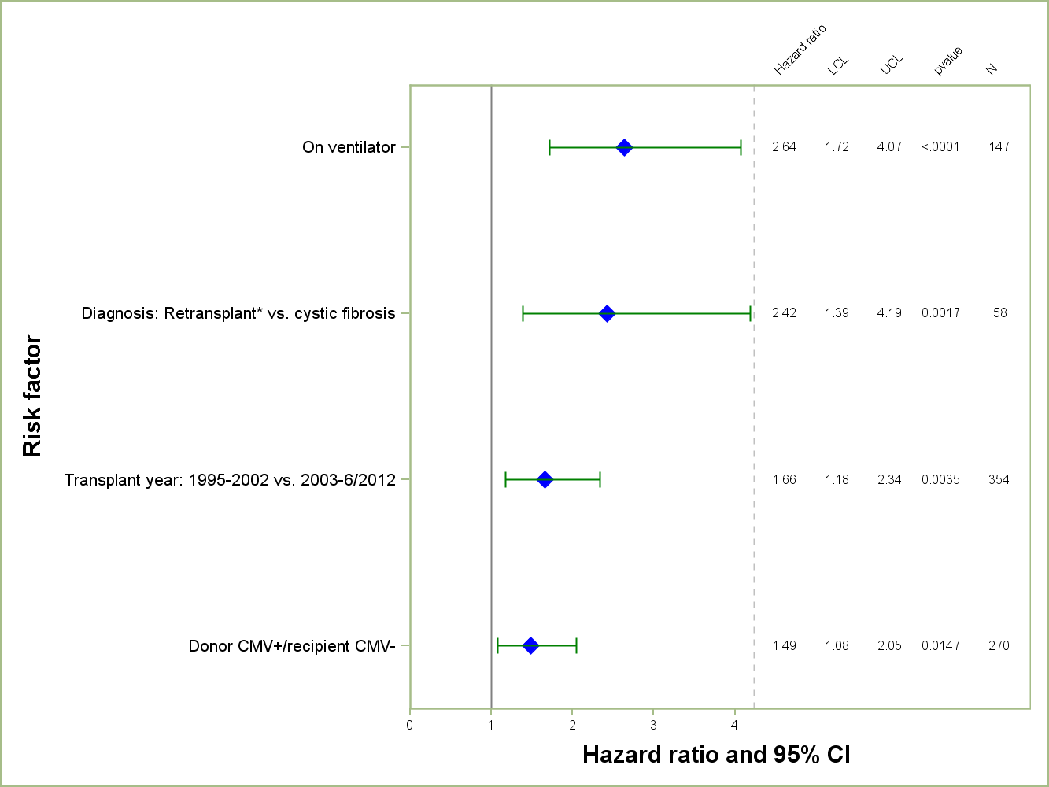
Pediatric Lung Transplants (January 1995 – June 2012)
Risk Factors For 1 Year Mortality/Graft Failure
N = 852
2014
* Retransplant includes those with a retransplant diagnosis or a previous transplant was reported.
JHLT. 2014 Oct; 33(10): 1025-1033
Notes:
Multivariable analysis was performed using a proportional hazards model censoring all patients at 1 year. Continuous factors were fit using a restricted cubic spline.
Analyses were limited to transplants having essentially complete information regarding risk factors.

Slide 63
Pediatric Lung Transplants (January 1995 – June 2012)
Risk Factors For 1 Year Mortality/Graft Failure
Continuous Factors (see figure)
Recipient age
2014
JHLT. 2014 Oct; 33(10): 1025-1033
Notes:
Multivariable analysis was performed using a proportional hazards model censoring all patients at 1 year. Continuous factors were fit using a restricted cubic spline.
Analyses were limited to transplants having essentially complete information regarding risk factors.

Slide 64
Pediatric Lung Transplants (January 1995 – June 2012)
Risk Factors For 1 Year Mortality/Graft Failure
Recipient Age
p = 0.0210
2014
JHLT. 2014 Oct; 33(10): 1025-1033
Notes:
Multivariable analysis was performed using a proportional hazards model censoring all patients at 1 year. Continuous factors were fit using a restricted cubic spline.
Analyses were limited to transplants having essentially complete information regarding risk factors.

Slide 65
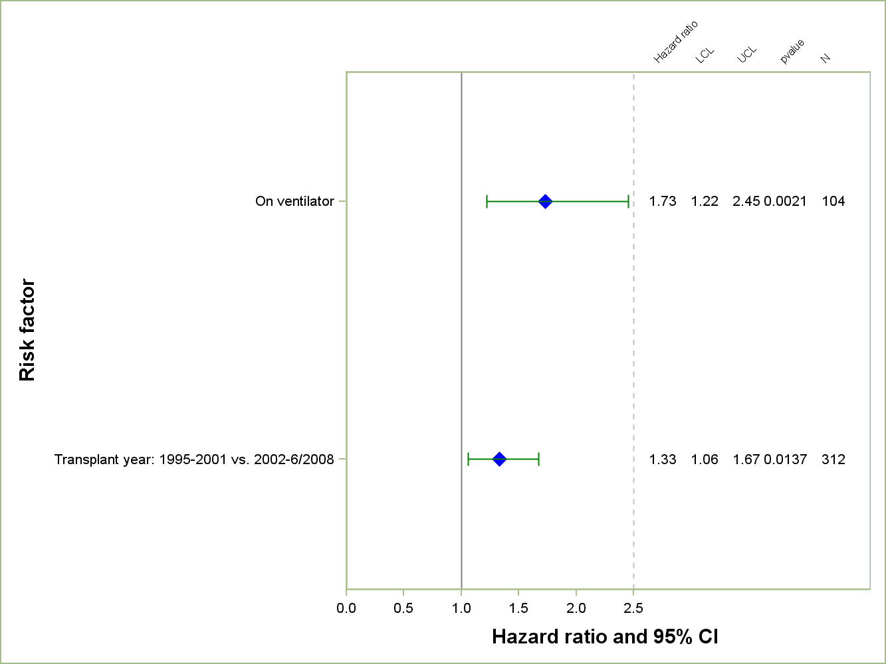
Pediatric Lung Transplants (January 1995 – June 2008)
Risk Factors For 5 Year Mortality/Graft Failure
2014
N = 646
JHLT. 2014 Oct; 33(10): 1025-1033
Notes:
Multivariable analysis was performed using a proportional hazards model censoring all patients at 5 years. Continuous factors were fit using a restricted cubic spline.
Analyses were limited to transplants having essentially complete information regarding risk factors.

Slide 66
Pediatric Lung Transplants (January 1995 – June 2008)
Risk Factors For 5 Year Mortality/Graft Failure
Continuous Factors (see figures)
Recipient age
Pediatric transplant center volume
2014
JHLT. 2014 Oct; 33(10): 1025-1033
Notes:
Multivariable analysis was performed using a proportional hazards model censoring all patients at 5 years. Continuous factors were fit using a restricted cubic spline.
Analyses were limited to transplants having essentially complete information regarding risk factors.

Slide 67
Pediatric Lung Transplants (January 1995 – June 2008)
Risk Factors For 5 Year Mortality/Graft Failure
Recipient Age
p = 0.0095
2014
JHLT. 2014 Oct; 33(10): 1025-1033
Notes:
Multivariable analysis was performed using a proportional hazards model censoring all patients at 5 years. Continuous factors were fit using a restricted cubic spline.
Analyses were limited to transplants having essentially complete information regarding risk factors.

Slide 68
Pediatric Lung Transplants (January 1995 – June 2008)
Risk Factors For 5 Year Mortality/Graft Failure
Center Volume Pediatric Transplants
p = 0.0051
2014
JHLT. 2014 Oct; 33(10): 1025-1033
Notes:
Multivariable analysis was performed using a proportional hazards model censoring all patients at 5 years. Continuous factors were fit using a restricted cubic spline.
Analyses were limited to transplants having essentially complete information regarding risk factors.

Slide 69
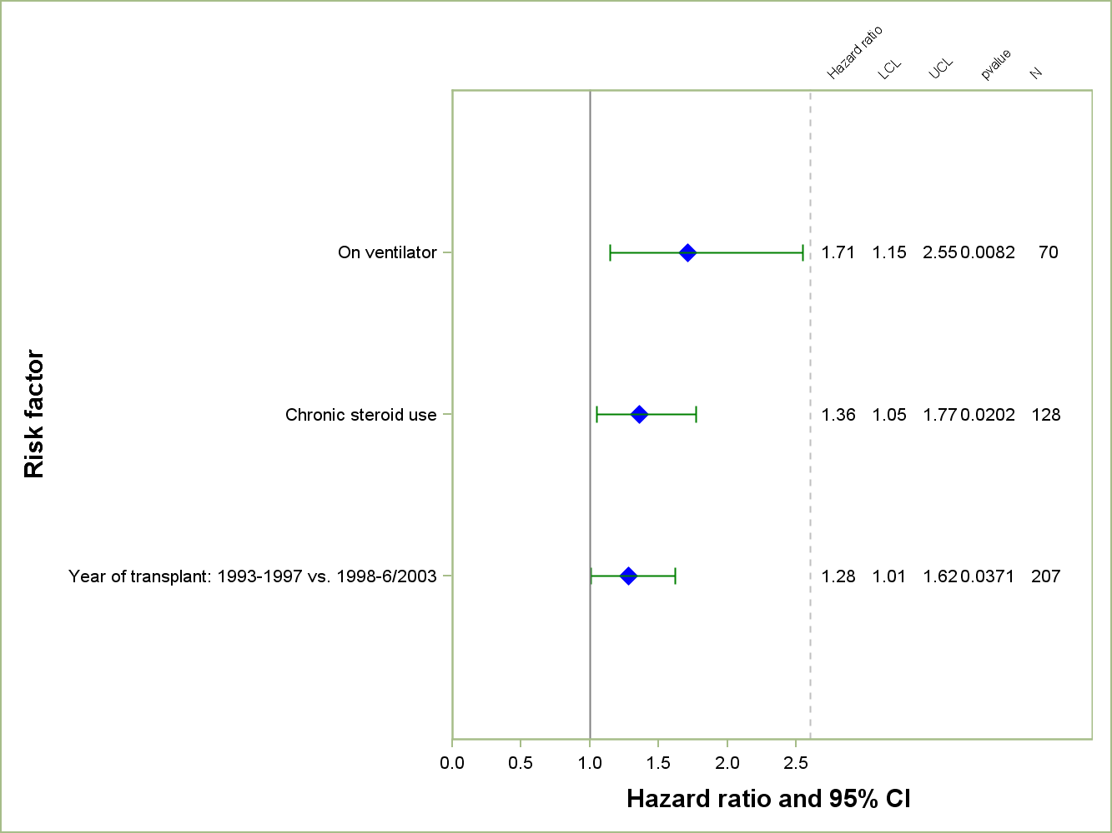
Pediatric Lung Transplants (January 1993 – June 2003)
Risk Factors For 10 Year Mortality/Graft Failure
N = 441
2014
NOTE: No continuous factors were significant.
JHLT. 2014 Oct; 33(10): 1025-1033
Notes:
Multivariable analysis was performed using a proportional hazards model censoring all patients at 10 years. Continuous factors were fit using a restricted cubic spline.
Analyses were limited to transplants having essentially complete information regarding risk factors.

